Slide 1
OTT Platform User Analytics
Team Member:
Lakshya Bhatia
Akshaya
Topic no: 5
Batch No: DA634S63
Project guide: komilla Bhatia

Slide 2
Business problem and target audience
Business Problem: OTT platforms have a lot of user data, but it is difficult to understand what increases watch time and engagement. Many users use free subscription which impacts profitability.
Objectives: Identify lowest and highest watch time and suggest strategy to improve How to convert "Subscription Type": from basic to Premium Bucket users to understand who are consider as high risk of quitting the platform. Identify: Prospective users At Risk users High Engagers | Target Audience: Senior Management of OTT platform Investment team of OTT platform Marketing team of OTT platform

Slide 3
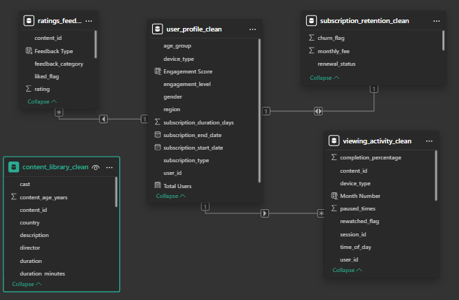
Overview of dataset
The dataset is based on an OTT streaming platform and shows how users interact with content.
There are around 2000 users
and 30K+ viewing sessions in
total .We have 5 tables :
User Profile
Viewing Activity
Ratings & Feedback
Subscription Data
Content Library

Slide 4
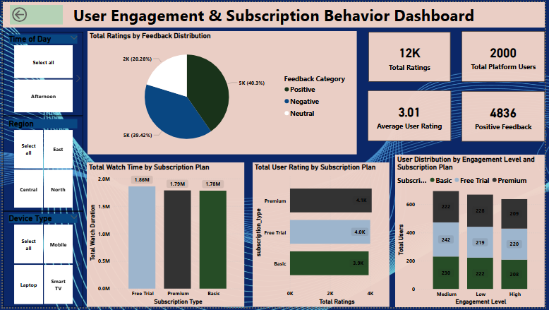
12K ratings from 2000 users show strong platform activity.
Positive feedback (40.3%) indicates good user satisfaction.
Free Trial users have the highest watch time (1.86M).
Premium users are the most active in giving ratings (4.1K).
Main focus: convert engaged Free Trial users to Premium for higher retention and revenue.

Slide 5
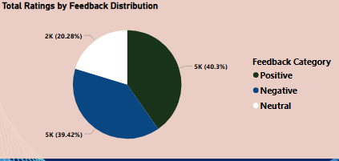
Insight 1: Feedback Distribution
Feedback Distribution Around 40% of users gave positive feedback, but nearly the same share (39%) reported negative experiences, with 20% feeling neutral. | Business Action: Create a feedback form for suggestions and improve based on user recommendations ,reducing buffering so user may get better experience.

Slide 6
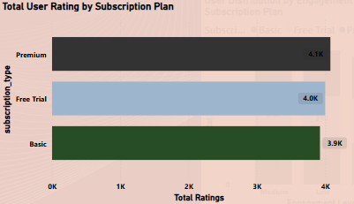
INSIGHT 2: Total rating across subscription plan
Interpretation of Visual: Premium users show slightly higher ratings (~4.1K), followed by Free Trial (~4.0K) and Basic users (~3.9K). | Business Action Have excellent content with celebrities only for premium users instead of all basic users.

Slide 7
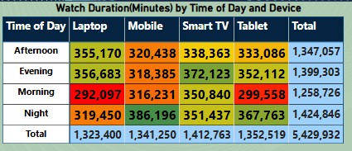
Insight 3: Engagement Level
Interpretation of visual: Most users are active at night which gives 1.42M minutes watch time and whereas morning is lowest with 1.25M minutes. | Business Action We should schedule are most of the content at nighttime between 9 Pm to 12 Pm because as we already seen trends in matrix table and usually this type all the users want to binge watch shows. For increasing morning watch time have content like sober music or religious music

Slide 8
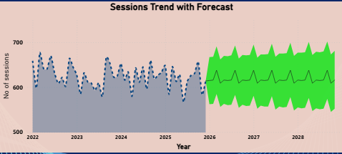
INSIGHT 4: Predicting future patterns of sessions
Interpretation of visual: Session total are 30K, but it is not growing. Forecast also looks stable like not any bigger spike which tells we are retaining our current users but not able to scale up on them. | Business Action We can run new campaigns to attract new users like heavy discount, new content regularly and if it works, we can increase the scale for it

Slide 9
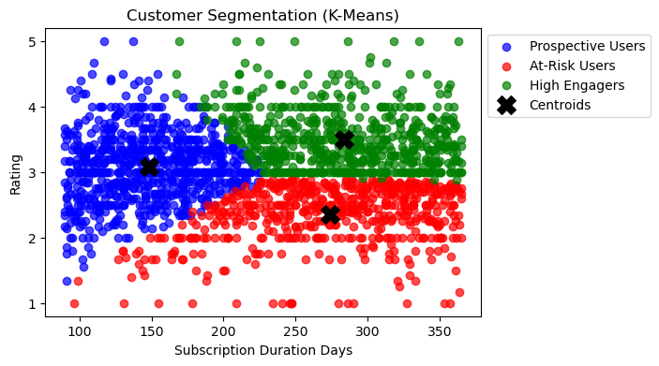
MACHINE LEARNING MODELS
(K-Means was implemented for User Segmentation & Engagement Analysis)
The ML model segmented OTT users into 3 distinct groups based on their subscription duration and ratings.
1. Prospective Users:-Users with shorter subscriptions and moderate engagement on the platform (represented in Blue).
2. At-Risk Users:-Users showing lower satisfaction levels and higher chances of churn (represented in Red).
3. High Engagers:-Highly active users with longer subscriptions and better ratings (represented in Green).
Notes:
Based on elbow curve we took k=2
Silhouette Score: 0.5586753768377206
Davies-Bouldin Score: 0.5428148388252839
Calinski-Harabasz Score: 7258.010014857899

Slide 10
Why Are At-Risk Users Not Happy?
At-Risk users have the lowest average rating (2.35) among all segments.
Their subscription duration is high (274 days), showing they stayed on the platform for a long time but remained dissatisfied.
Completion percentage is almost like other users, which suggests they are watching content but not enjoying it enough to rate it positively.
SUGGESTED SOLUTIONS
Recommend more personalized content based on users’ watch history and preferred genres.
Push trending and highly-rated shows to improve overall viewing satisfaction.
Introduce retention strategies such as loyalty benefits, premium trials, or special renewal offers for long-term users.
Analyze low-rated content categories to better understand changing audience preferences and improve content strategy.

Slide 11
Machine Learning algorithm: Logistic Regression
Purpose of the ML model: The model can correctly Predict customer churn (whether the customers will return to the OTT platform or not) based on 5 parameters shared by the user.
Input Data: 'watch_duration_minutes', 'completion_percentage', 'subscription_duration_days', 'paused_times', 'monthly_fee'
Output of ML model: churn_flag
Model Performance: Model is reliable Accuracy: 70% F1 score: 68%
Machine Learning algorithm: KNN Classifier
Purpose of the ML model: The model can correctly predict the subscription type (Free Trial, Basic, Premium) based on user behavior and usage patterns.
Input Data:‘watch_duration_minutes’, ‘completion_percentage’, ‘paused_times’, ‘rating’, ‘subscription_duration_days’
Output of ML model: subscription_type
Model Performance: Model is reliable Accuracy: 75% F1 score: 75%

Slide 12
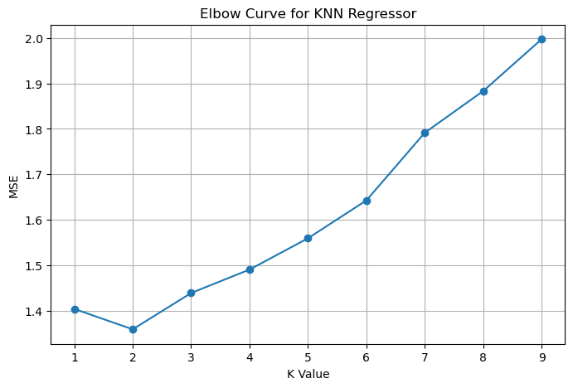
Machine Learning algorithm: KNN Regressor
Purpose of the ML model: The model predicts the popularity score of OTT content using nearest-neighbor similarity patterns.
Input Data: duration numeric, engagement proxy, genre count, content age years
Output of ML model: Popularity score
Model Performance: R² Score: 90.76% MSE: 1.36
Best K value = 2

Slide 13
statistical test: T-test
. We conducted a T-Test to analyze whether churned users watch content differently compared to non-churned users. This helps us understand if watch time is a strong indicator of user retention.
No Significant Difference Found in Watch Time between Churned and Active Users
BUSINESS DECISION:
Watch time alone does not explain churn behavior. The platform should not rely solely on increasing watch duration to improve retention and should explore other engagement factors.
Notes:
T-test
H0: No difference in watching time HA: Difference exist in watch time
T-stat: -1.2778281613255003
P-value: 0.2013199106136922
Alpha=5%
Output: No significant difference Fail to reject H0

Slide 14
statistical test: CHI-SQUARE TEST
We conducted a Chi-Square Test to analyze whether subscription type influences churn behavior.
This helps identify if certain subscription plans are more prone to user drop-off.
Significant Relationship Found between Subscription Type and Churn Flag
BUSINESS DECISION:
Subscription type impacts churn. The platform should design plan-specific retention strategies, such as improving value perception or benefits in plans with higher churn.
Notes:
Chi-square test
Subscription Type vs Churn Flag
Chi-square: 5516.863190609802
P-value: 0.0
Alpha=5%
Output: significant relation between subscription type and churn flag which means they affect each other.

Slide 15
Summary
Total activity is stable with ~30,000 sessions, but no strong growth trend is visible
Free users generate the highest watch time (~1.86M minutes) compared to Premium (~1.79M) and Basic (~1.78M)
User feedback is almost evenly split
Positive: ~40%
Negative: ~39%
Neutral: ~20%
Average content completion is only ~52%, meaning users are watching just half of the content
Peak usage happens at night (~1.42M minutes), which is higher than other time periods

Slide 16
CONCLUSION
Main concern we can retain the customers, but growth is not observed. Suggestions for growth:
How to increase watch time For Morning content: Include light musical content like sober music or religious songs like bhajans, Gurbani or hymns or regional songs like Karnatic music
How to convert "Subscription Type":
from basic to Premium: Keep celebrities-based content for only premium users
Bucket users to understand who are consider as high risk of quitting the platform. Identify:
Prospective users: most users leave subscription after 200 days . New series in every genre should be released after every 150 days.
At Risk users: from the new feedback we have collected, improve the features of the app based on user recommendations
High Engagers : In night there is highest spike of usage of 1.42 M minutes , so we can plan new series or show releases at night as it will attract more users compare to usual time.

